Slide 1

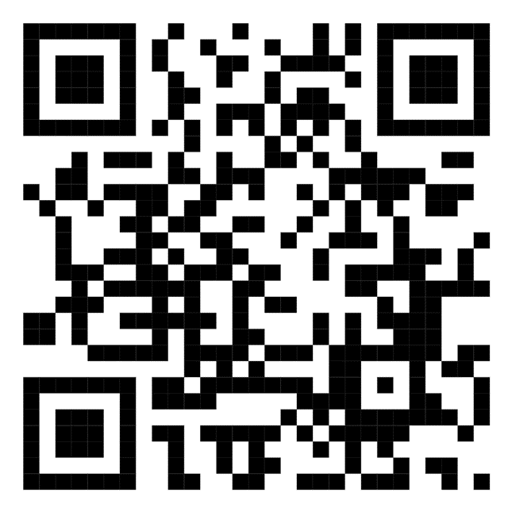
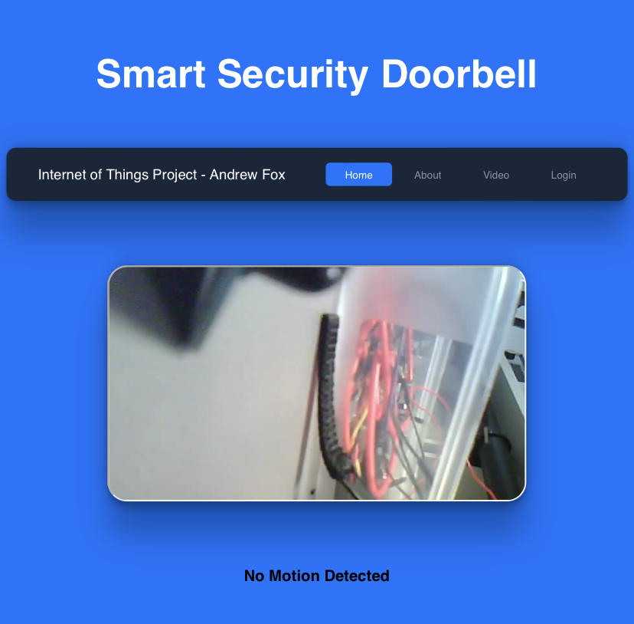
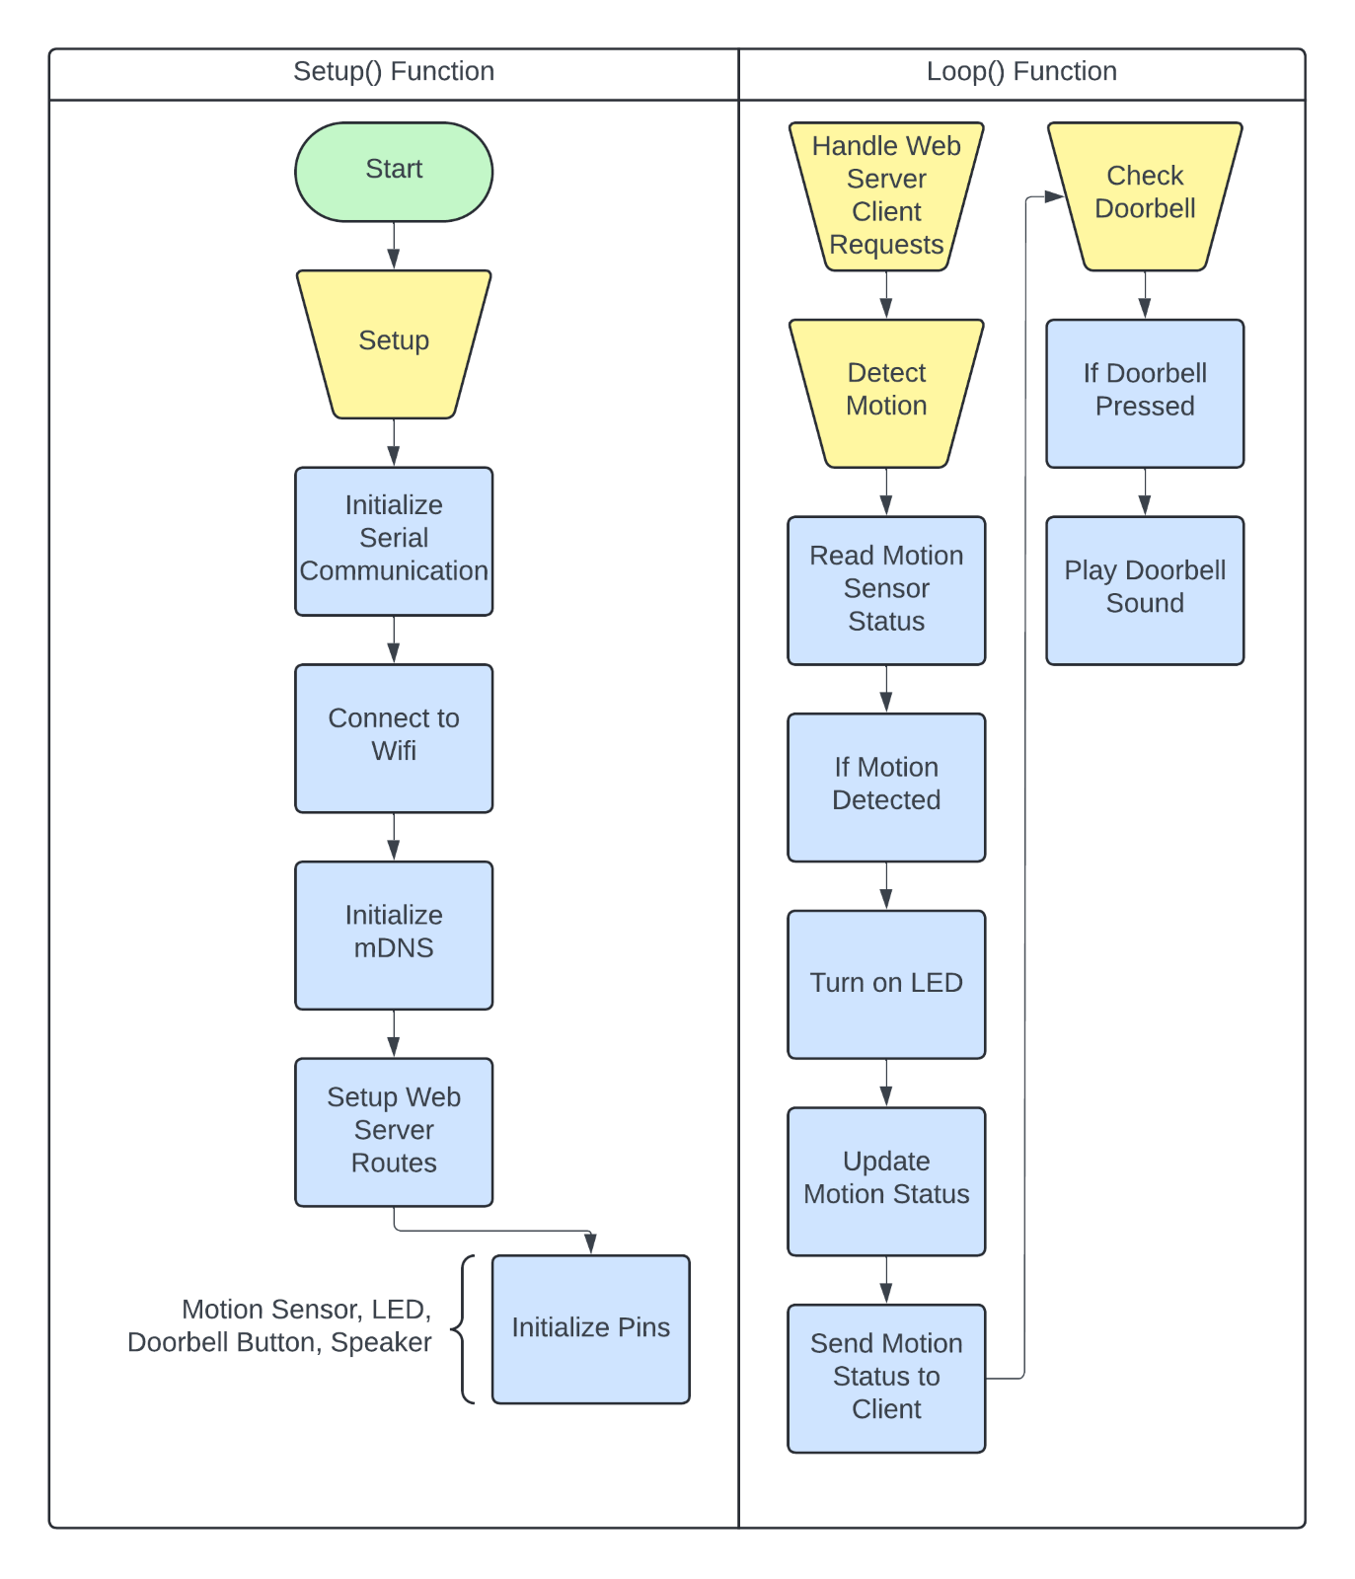
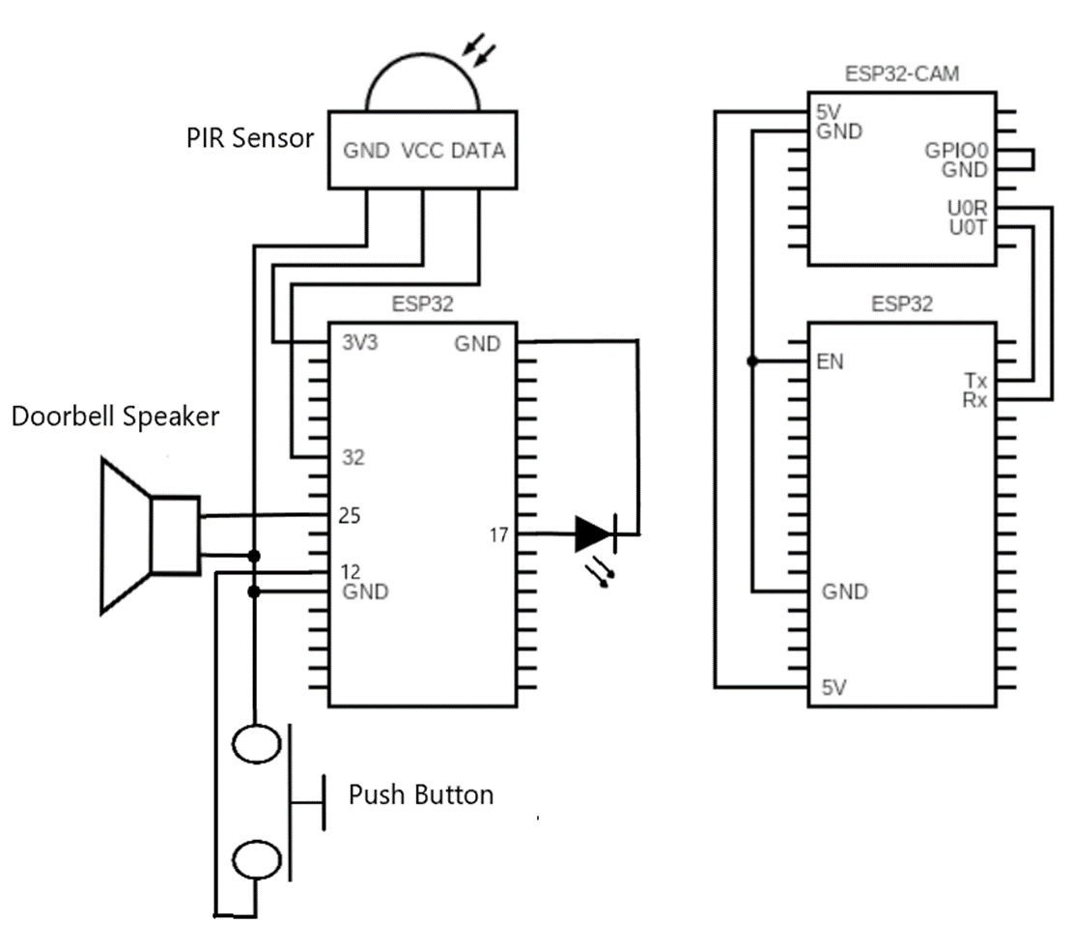
Internet of Things Year 2 Project
DoorGuard
Advanced Doorbell Surveillance System
Andrew Fox
Project Summery
Architecture Diagram
Website Design
"DoorGuard": An IoT project that integrates a Camera, PIR sensor and has web connectivity for real-time (30fps) video feeds and motion detection alerts, enhancing home security.
ESP32
WebsitePir.ino
OUTPUTS
Wi-Fi
Speaker
Data Input
LED
INPUTS
Data Output
Schematic and Flowchart
PIR Sensor
C / C + +
Button
HTML / CSS
JavaScript
Webpage
Web Server
Arduino IDE
Sensor Readings
ESP32
Live Video Stream
CameraWebServer.ino
Wi-Fi
Data Input
iFrame
Data Output
ESP32-Cam
C / C + +
Sustainable Development Goals
Camera Module
HTML / CSS
Camera Web Server
Arduino IDE
Target 11.1 – safe and affordable housing
DoorGuard offers affordable and effective surveillance, contributing to safer homes worldwide.
Skills and Technologies
Target 16.3 – Rule of Law and Access to Justice DoorGuard helps gather evidence and supports law enforcement efforts through surveillance.
C Programming
Embedded Systems
Hardware interface design
Web Development
Problem Solving
Interactive Website
ESP32 microcontroller
ESP32-CAM
PIR sensor
LED
Button
Speaker
Target 3 – Health and Well-being
Providing peace of mind and reducing stress knowing your home is secure

